Slide 1
Designing Distributed Systems with TLA+
Hillel Wayne hillelwayne.com @hillelogram

Slide 2
Everything About Distributed Systems is Terrible
Hillel Wayne hillelwayne.com @hillelogram

Slide 3
Waterfall is Good, Actually
Hillel Wayne hillelwayne.com @hillelogram

Slide 4
Outline
What is a Distributed System? (distsym)
Why are they terrible?
Why don't most tools work?
How can TLA+ help?

Slide 5
Disclaimer: this is like 30% a sales pitch
Notes:
Formal Methods

Slide 6
Disclaimer: Zoom talks are horrible
Notes:
Formal Methods

Slide 7
hillelwayne.com/talks/distributed-systems-tlaplus
Notes:
Formal Methods

Slide 8
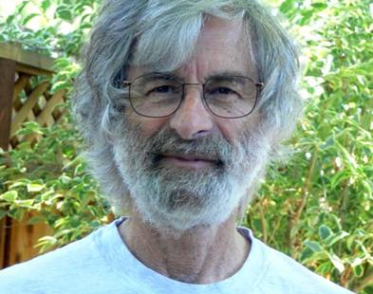
Things Lamport did
TLA+
Paxos
Bakery Algorithm
Byzantine Generals
LaTeX
Many hats
Notes:
Invented by Leslie Lamport
Lamport revolutionized everything
"Math is more expressive than programming, so it would make great blueprints"

Slide 9
"A distributed system is one in which the failure of a computer you didn't even know existed can render your own computer unusable."
Leslie Lamport
Notes:
You're gonna be seeing Lamport's name a lot

Slide 10
Computer 1
Computer 2
tmp = serverdb.get(x)
serverdb.set(x, tmp + 1)
tmp = serverdb.get(x)
serverdb.set(x, tmp + 1)

Slide 11
Thread 1
Thread 2
tmp = x
x = tmp + 1
tmp = x
x = tmp + 1

Slide 12
Computer
Thread
tmp = serverdb.get(x)
serverdb.set(x, tmp + 1)
tmp = x
x = tmp + 1

Slide 13
Threads = Computers
Notes:
both are hard problems

Slide 14
Threads =ish Computers
Notes:
both are hard problems

Slide 15
Distributed System
Multiple agents
Global properties
Localized information
Partial Failure
Notes:
Which is harder?

Slide 16
Concurrency

Slide 17
global x = 1
agent 1
agent 2
x = x + 1
x = x * 2
Notes:
Assume + and * are atomic

Slide 18
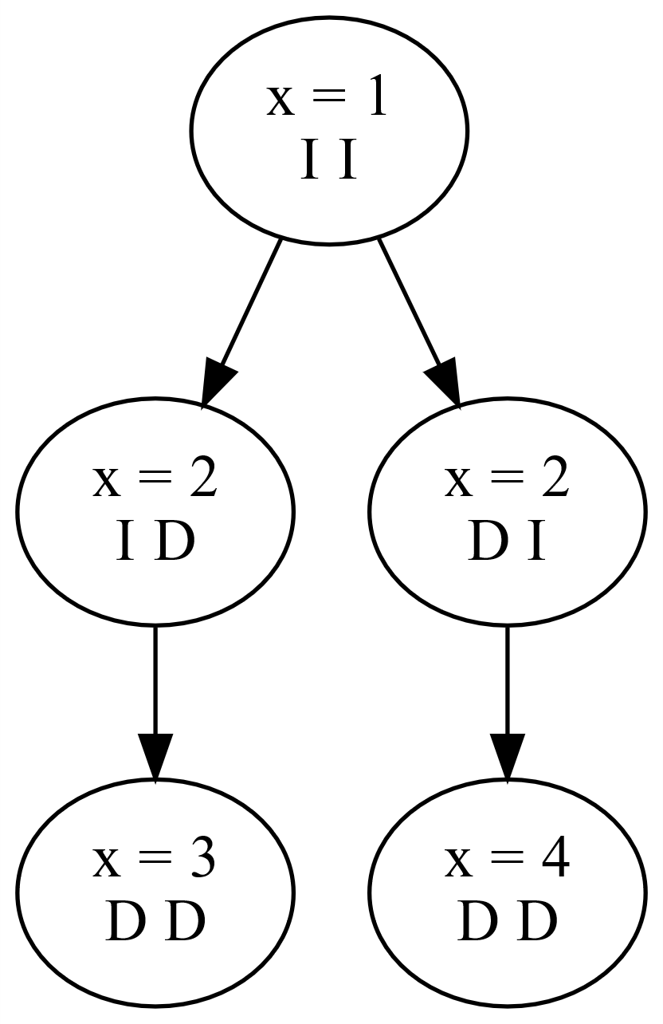

Slide 19




Slide 20
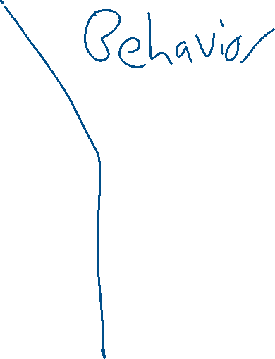
Notes:
Technically 5

Slide 21
global x = 1
agent 1
agent 2
local tmp = x
x = tmp + 1
local tmp = x
x = tmp * 2

Slide 22
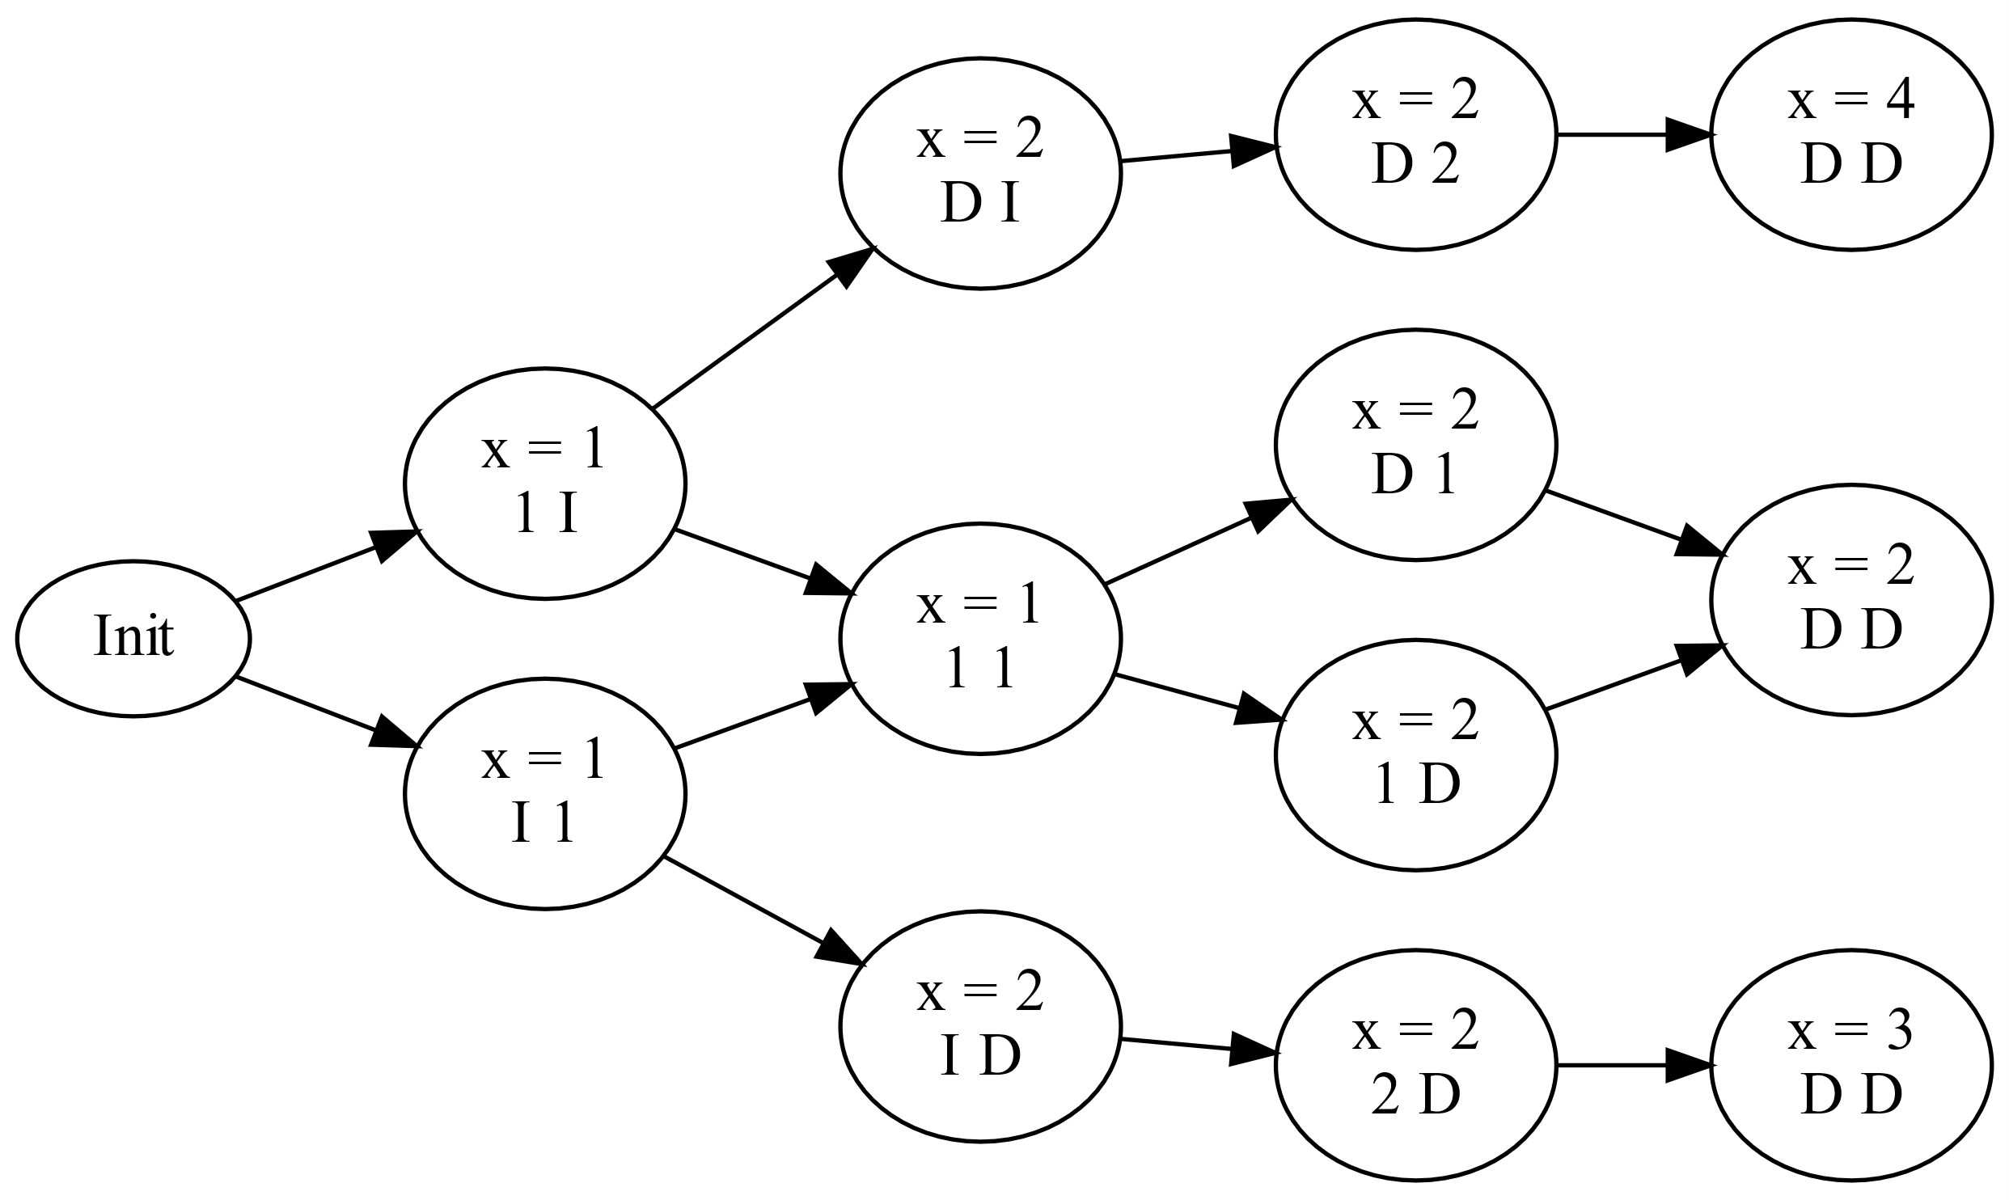
Notes:
13/ 6

Slide 23
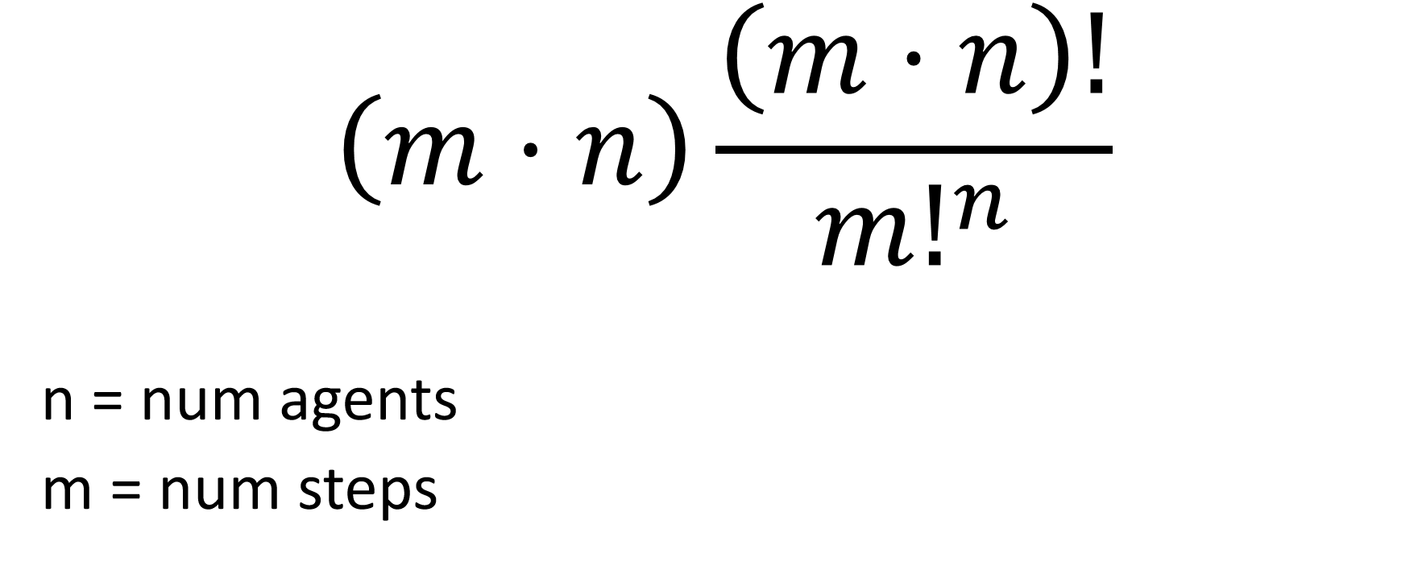
$$\left(m⋅n\right)\frac{\left(m⋅n\right)!}{{m!}^{n}}$$
n = num agents
m = num steps

Slide 24
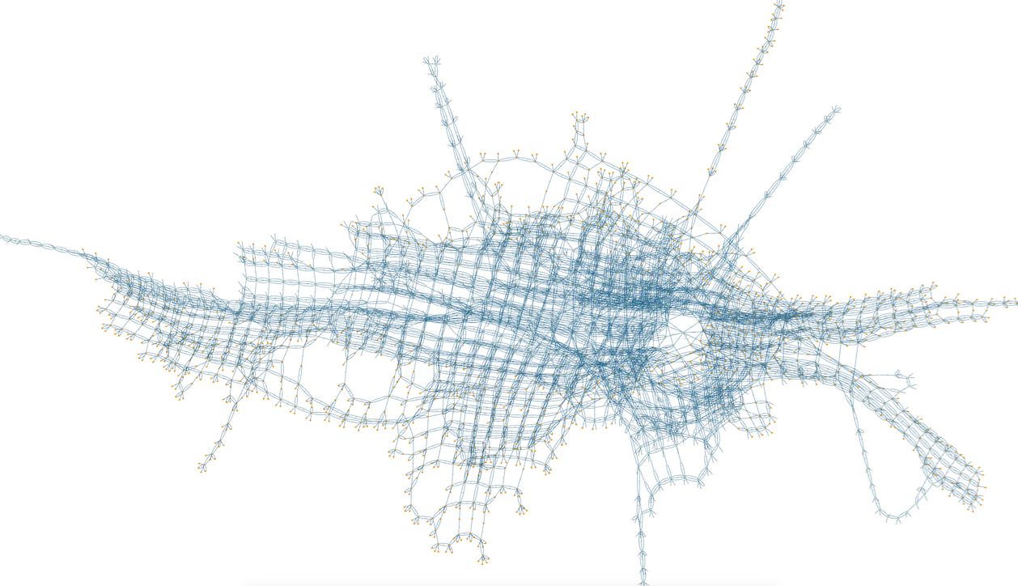
https://www3.hhu.de/stups/prob/index.php/State_space_visualization_examples
Notes:
State spaces get very big very fast

Slide 25
The number of states grows fast
Notes:
What about partial crashes?

Slide 26
Nondeterminism

Slide 27
x = 0
x = x + 1
or
x = x + 2
or
whoops crash
Notes:
If we want partial failure

Slide 28
x = 0
while true:
if x < 6:
x = x + 1
while true:
if x > 0:
x = x - 1

Slide 29
Notes:
16 distinct 5 step behaviors

Slide 30
x = 0
while true:
if x < 6:
x = x + 1
or
if x < 5:
x = x + 2
while true:
if x > 0:
x = x - 1

Slide 31
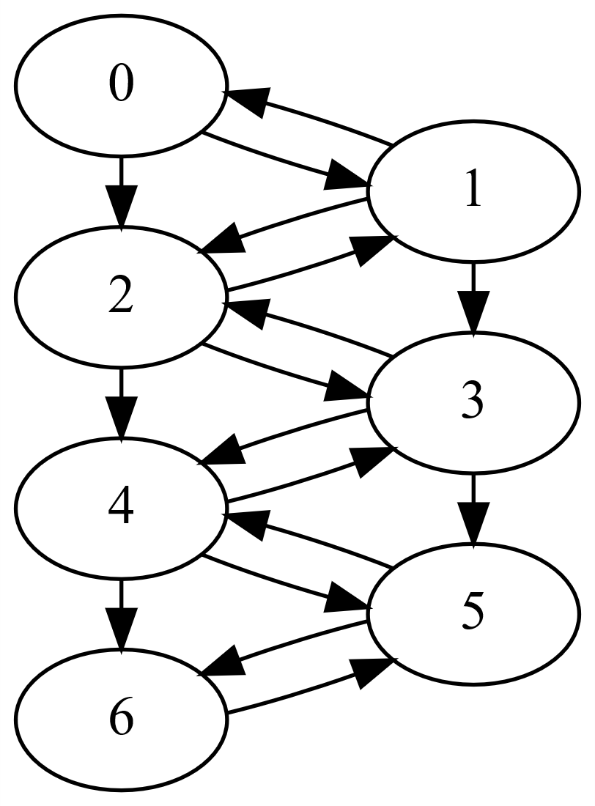
Notes:
Lots of transitions

Slide 32

https://www3.hhu.de/stups/prob/index.php/State_space_visualization_examples
Notes:
Cone of possibilities

Slide 33
The number of behaviors grows very fast

Slide 34
https://www3.hhu.de/stups/prob/index.php/State_space_visualization_examples
Notes:
State spaces get very big very fast

Slide 35
https://www3.hhu.de/stups/prob/index.php/State_space_visualization_examples
Notes:
State spaces get very big very fast

Slide 36
https://www3.hhu.de/stups/prob/index.php/State_space_visualization_examples

Slide 37
https://www3.hhu.de/stups/prob/index.php/State_space_visualization_examples

Slide 38
Systems may have invalid behaviors and states

Slide 39
1 / 1,000,000,000 events
* 100 events / second
____________________________
4 / year

Slide 40
Over a long enough time, a system will do everything.
Notes:
One failure is too many

Slide 41
Anything that can go wrong, will go wrong.
Notes:
Murphies Law

Slide 42
Solutions

Slide 43
CAS
Transactions
STM
Locks
Semaphores
Promises
Nurseries
Async/await
Monads
Futures
Supervisors
Actors
Goroutines
FBP
Notes:
These are

Slide 44
https://www3.hhu.de/stups/prob/index.php/State_space_visualization_examples

Slide 45
Code is not design.

Slide 46
Code
Ineffective
Testable
Design
Effective
Untestable

Slide 47
Code
Ineffective
Testable
Design Formal Specification
Effective
Untestable

Slide 48
Formal Specification

Slide 49


Slide 50
Things Lamport did
TLA+
Paxos
Bakery Algorithm
Byzantine Generals
LaTeX
Many hats
Notes:
Invented by Leslie Lamport
Lamport revolutionized everything
"Math is more expressive than programming, so it would make great blueprints"

Slide 51
Programming
TLA+
let queue = []
queue has 0..5 msgs

Slide 52
Programming
TLA+
result = queue.add(msg)
if result == SUCCESS:
...
else:
...
Enqueue:
either
queue := queue (+) msg
or skip;
or
queue := queue (+) [msg, msg]
end either;

Slide 53
Programming
TLA+
for d in devices:
send_notification(d)
with ds in SUBSET devices do
for d in ds:
send_notification(d)
end with;

Slide 54
ALWAYS {
exists s in Servers: s.online
}
EVENTUALLY {
all s in Servers: s.online
}
Notes:
Once we have our spec, we can talk about properties

Slide 55
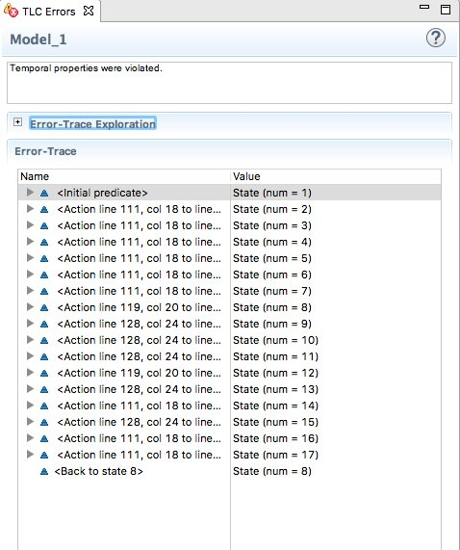
Notes:
Model checker

Slide 56


Uploading
Content Creation
Create Upload
<<trigger>>
Create Content
Edit Upload
<<trigger>>
Edit Content
Delete Upload
<<trigger>>
Delete Content
Notes:
UML

Slide 57
Specs do not check code.

Slide 58
Original
Slides
[a |-> b, c |-> d]
<<1, 2, 5>>
\E
{"a": b, "c": d}
[1, 2, 5]
\Exists

Slide 59
hillelwayne.com/talks/distributed-systems-tlaplus
Notes:
Go here for the stuff

Slide 60
EXTENDS Sequences, Integers, TLC
PARAMS Users, Workers, NULL

Slide 61
variables
uploads = {};
content = {};
queue = [];
next_id = 1;
Notes:
queue is a sequence

Slide 62
def send_msg(id, action): queue := Append(queue,
{"id": id, "action": action});

Slide 65
process user \in Users
begin
User:
while TRUE do
either
\* Create
or
\* Edit
or
\* Delete
end either;
end while;
end process;
Notes:
Green means can be expanded

Slide 66
either
Create
Edit
Delete
or
or
end either

Slide 67
Create
with
create = {"user": self,
"version": 1,
"id": next_id}
do
uploads := uploads ++ create;
send_msg(create.id, "create");
next_id := next_id + 1;
end with;

Slide 68
Delete
with
delete \in {u \in uploads:
u.user = self}
do
uploads := uploads -- delete;
send_msg(delete.id, "delete");
end with;

Slide 69
with delete
\in {a, b, c}
delete = a
delete = b
delete = c
or
or
end with

Slide 70
Edit
with
upload \in {u \in uploads: u.user = self},
edit = {"user": upload.from,
"id": upload.id,
"version": upload.version + 1}
do
uploads := uploads -- upload ++ edit;
send_msg(edit.id, "edit");
end with;

Slide 73
process worker \in Workers
variables
msg = NULL; local = NULL;
begin
Receive:
while TRUE do
await Nonempty(queue);
msg := Head(queue);
queue := Tail(queue);
\* process message code
end while;
end process;

Slide 74
Process Message Code
if msg.action = "create" then
Create:
elsif msg.action = "edit" then
StartEdit:
PushEdit:
elsif msg.action = "delete" then
Delete:
else \* wtf
assert FALSE;
end if;

Slide 75
Create
def UploadWith(msg_id):
CHOOSE upload \in uploads:
upload.id = msg_id

Slide 76
Create
with upload = UploadWith(msg.id) do
content := content ++ upload;
end with;

Slide 77
StartEdit
with
upload = UploadWith(msg.id),
exists = ContentWith(msg.id)
do
content := content -- exists; local := upload;
end with;

Slide 78
PushEdit
content := content ++ local;
local := NULL;

Slide 80
Comprehensiveness

Slide 81
PARAMS
Workers <- {w1}
Users <- {u1}

Slide 82
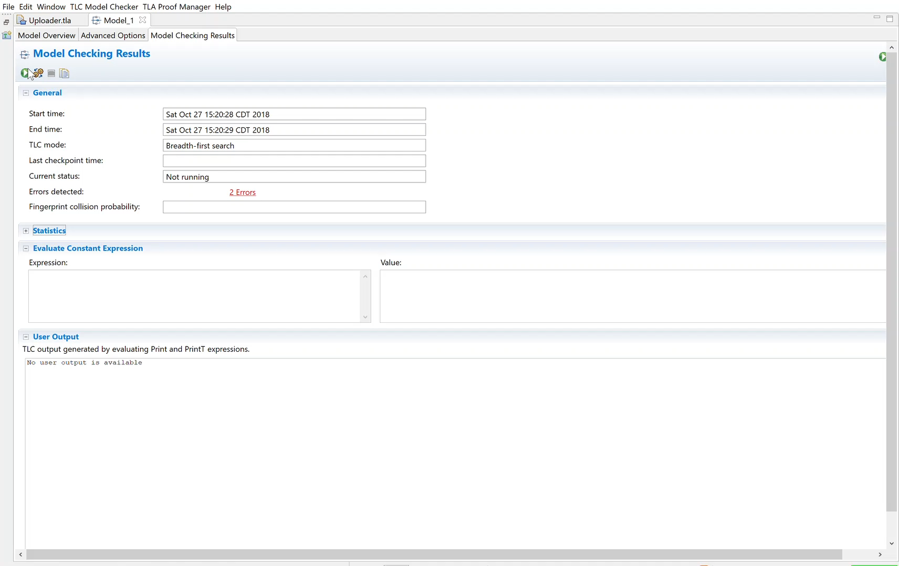

Slide 83
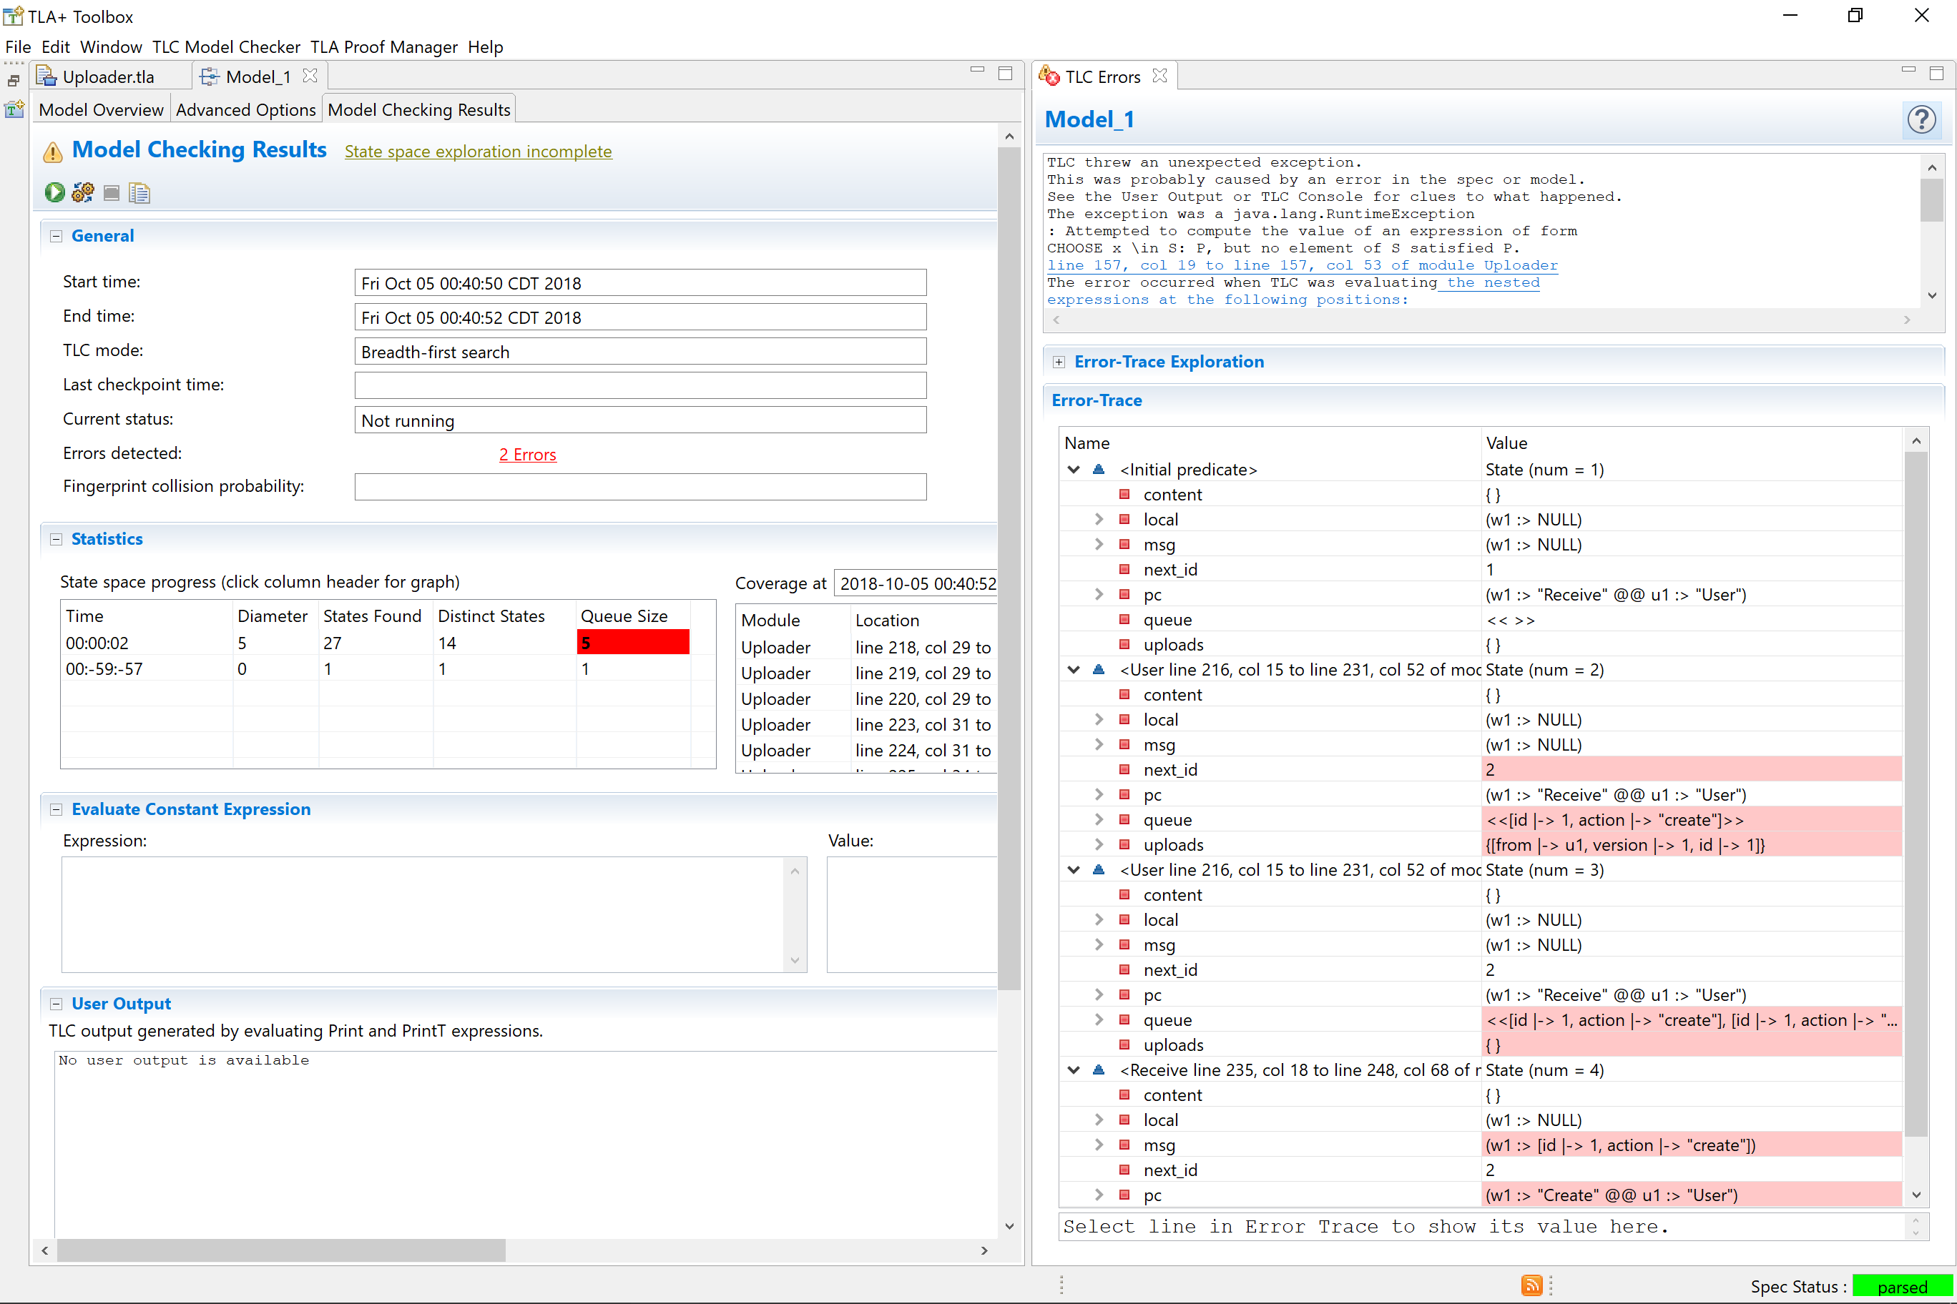

Slide 84
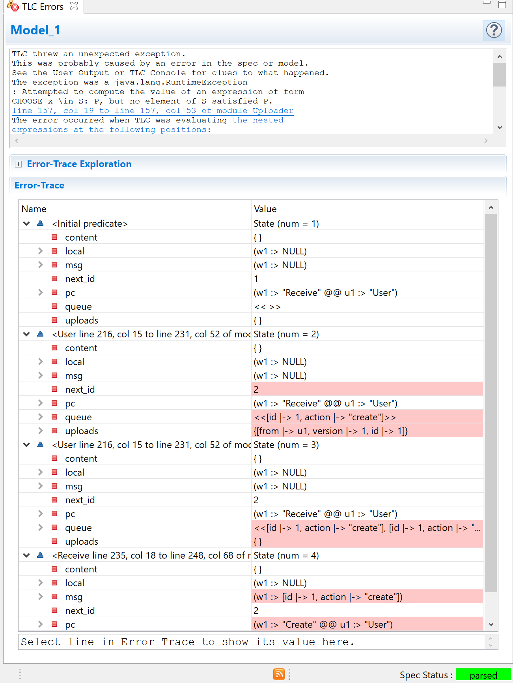



Slide 85
What happened?
User creates upload 1
User deletes upload 1
Worker receives "create 1"
Worker can't find upload 1

Slide 86
Create
with upload = UploadWith(msg.id) do
content := content ++ upload;
end with;

Slide 87
Create
if \Exists x \in uploads:
x.id = msg.id;
then
with upload = UploadWith(msg.id) do
content := content ++ upload;
end with;
end if

Slide 88
Create
if ExistsUploadWith(msg.id) then
with upload = UploadWith(msg.id) do
content := content ++ upload;
end with;
end if

Slide 89
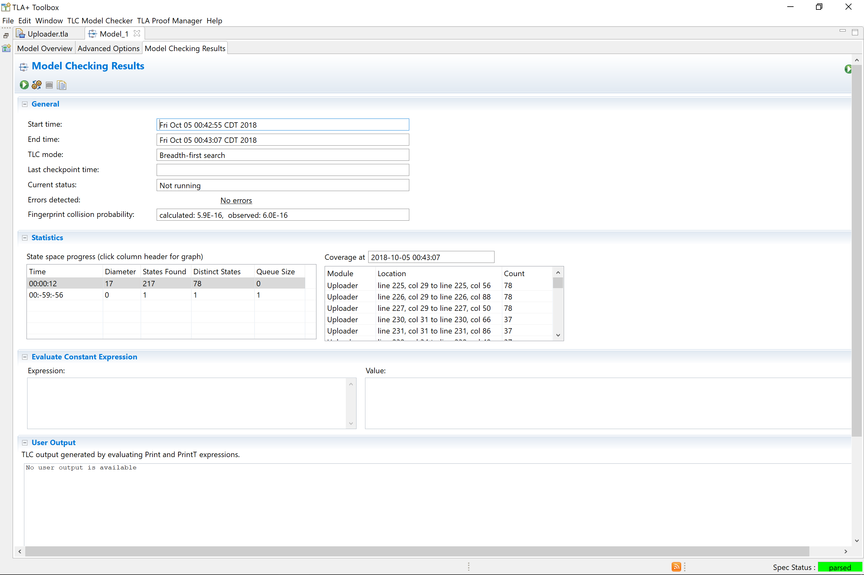

Slide 90
Properties

Slide 91
PROPERTY NoOrphanContent:
[]<>(
\Forall c \in content:
\Exists u \in uploads:
c = u
)

Slide 92
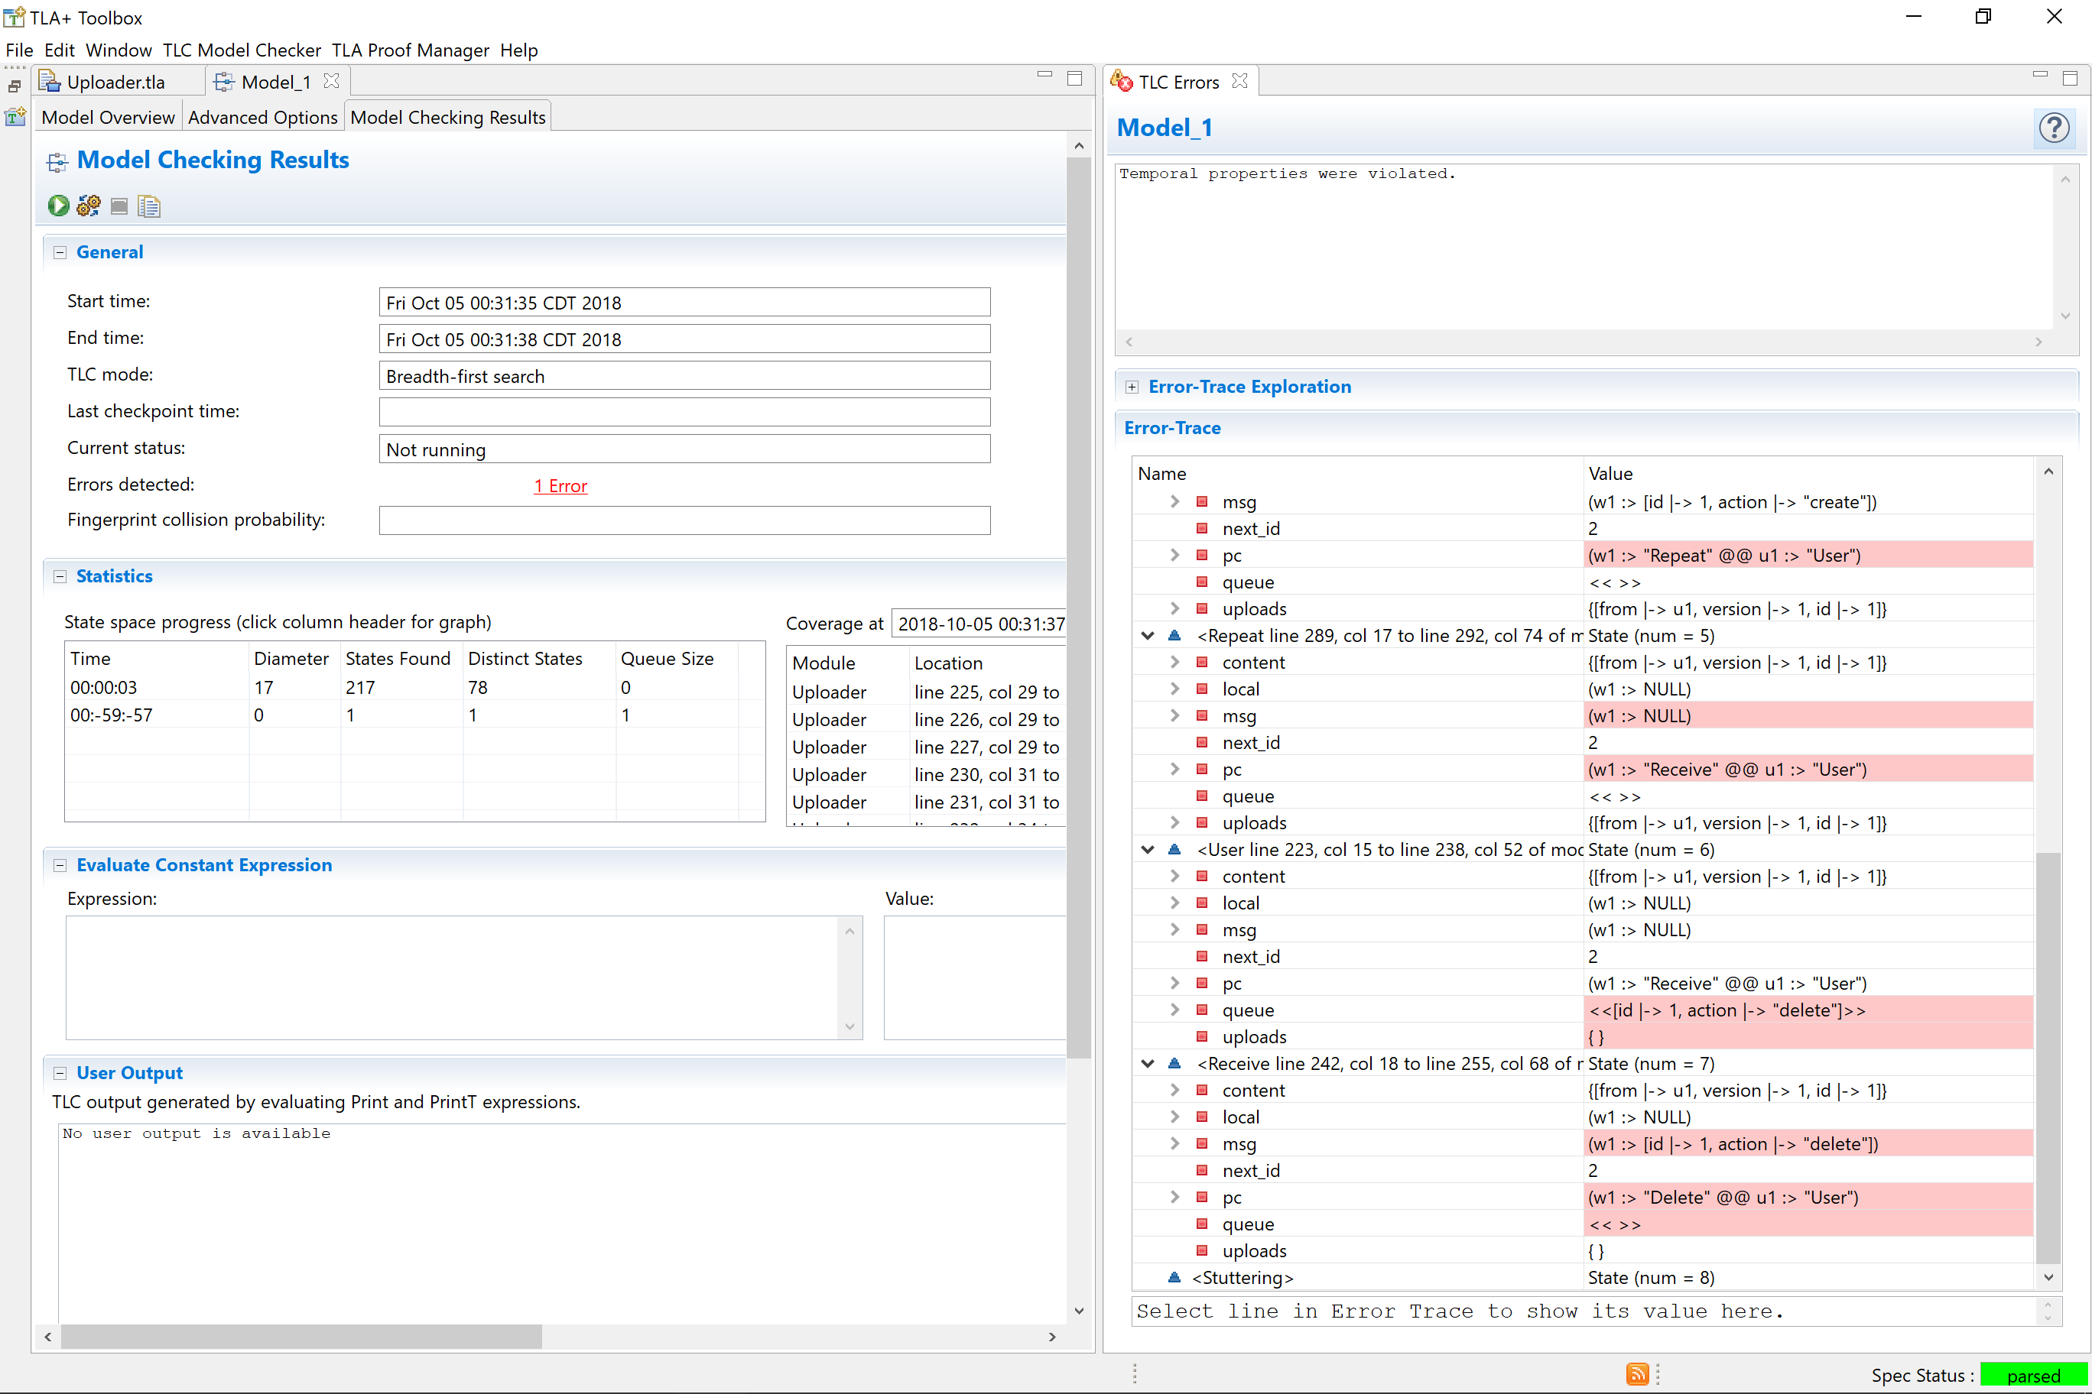

Slide 93
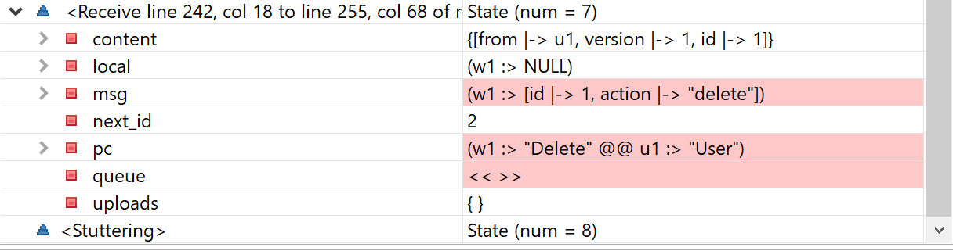

Slide 94
What happened?
User creates upload 1
Worker receives "create 1"
Worker creates content 1
User deletes upload 1
Worker receives "delete 1"
Worker crashes
Notes:
We need to be explicit about what whether things can crash or not

Slide 95
Fix
fair process worker \in Workers

Slide 96
Fix
fair process worker \in Workers

Slide 97
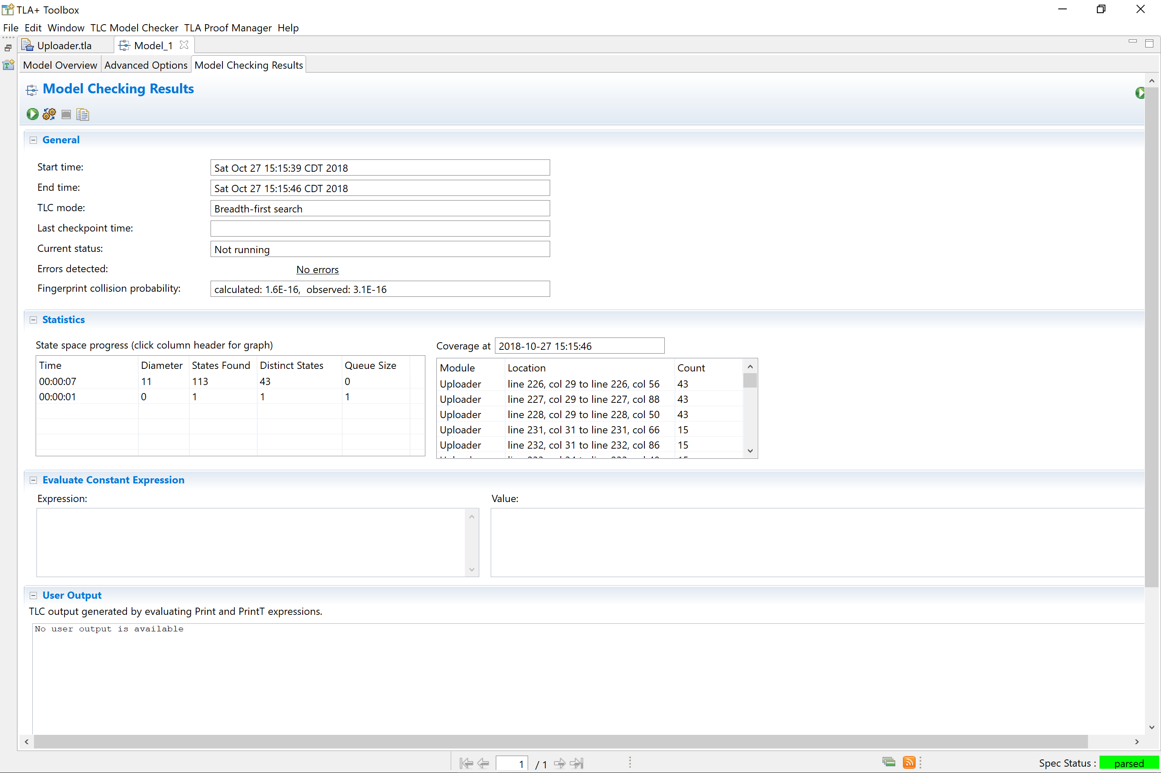

Slide 99
PARAMS
Workers <- {w1, w2}
Users <- {u1}

Slide 100
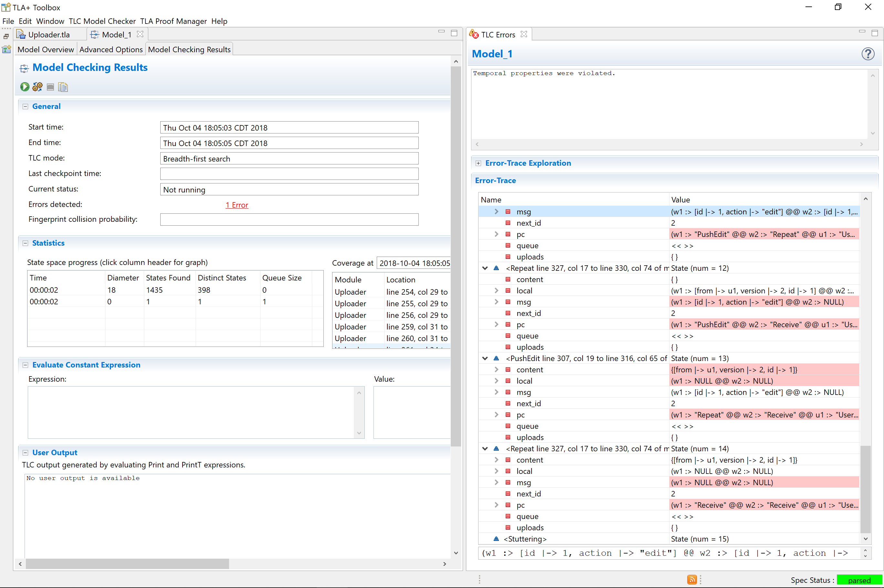
Notes:
Breaks if we delete

Slide 101
What happened?
User creates 1
Worker creates 1
User edits 1
W1 edits 1
User deletes 1
W2 deletes 1
W1 pushes edit

Slide 102
fair process cleaner = "cleaner"
begin
Clean:
while TRUE do
with
id \in
LET
upload_ids == {u.id: u \in uploads}
content_ids == {c.id: c \in content}
IN
content_ids \ upload_ids
, exists = ContentWith(id)
do
content := content -- exists;
end with;
end while;
end process;

Slide 103
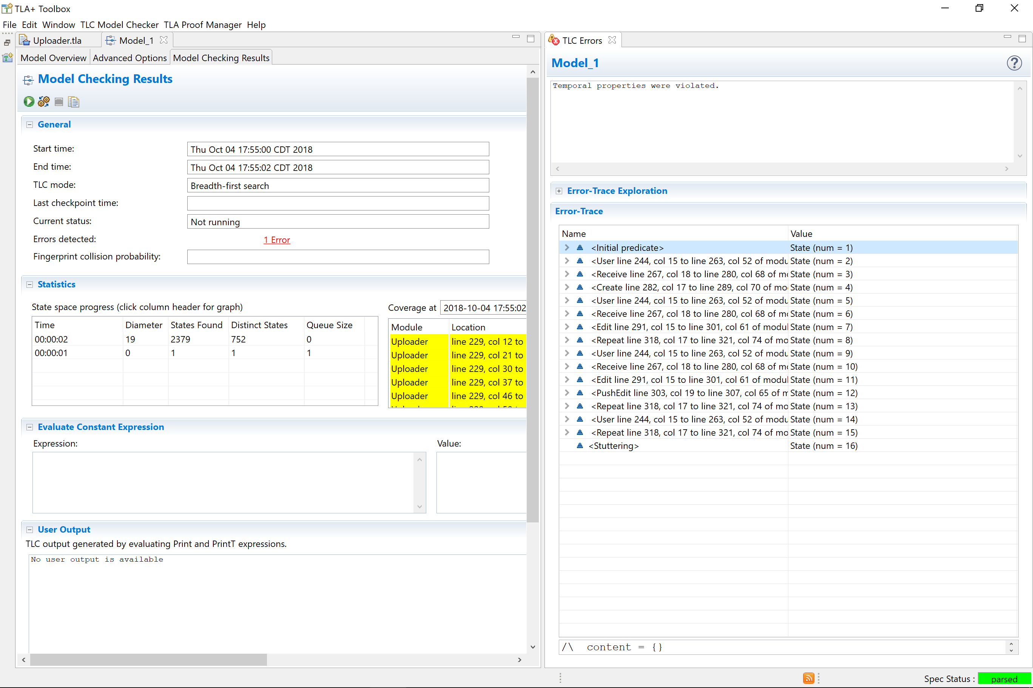

Slide 105
What happened?
User creates 1
Worker creates 1
User edits 1
W1 edits 1
User edits 1
W2 edits 1
W2 skips edit
W1 pushes edit

Slide 106
if
ExistsUploadWith(local.id)
and UploadWith(local.id).version > local.version
then
local := NULL;
goto Edit;
else
content := content ++ local;
local := NULL;
end if;

Slide 107
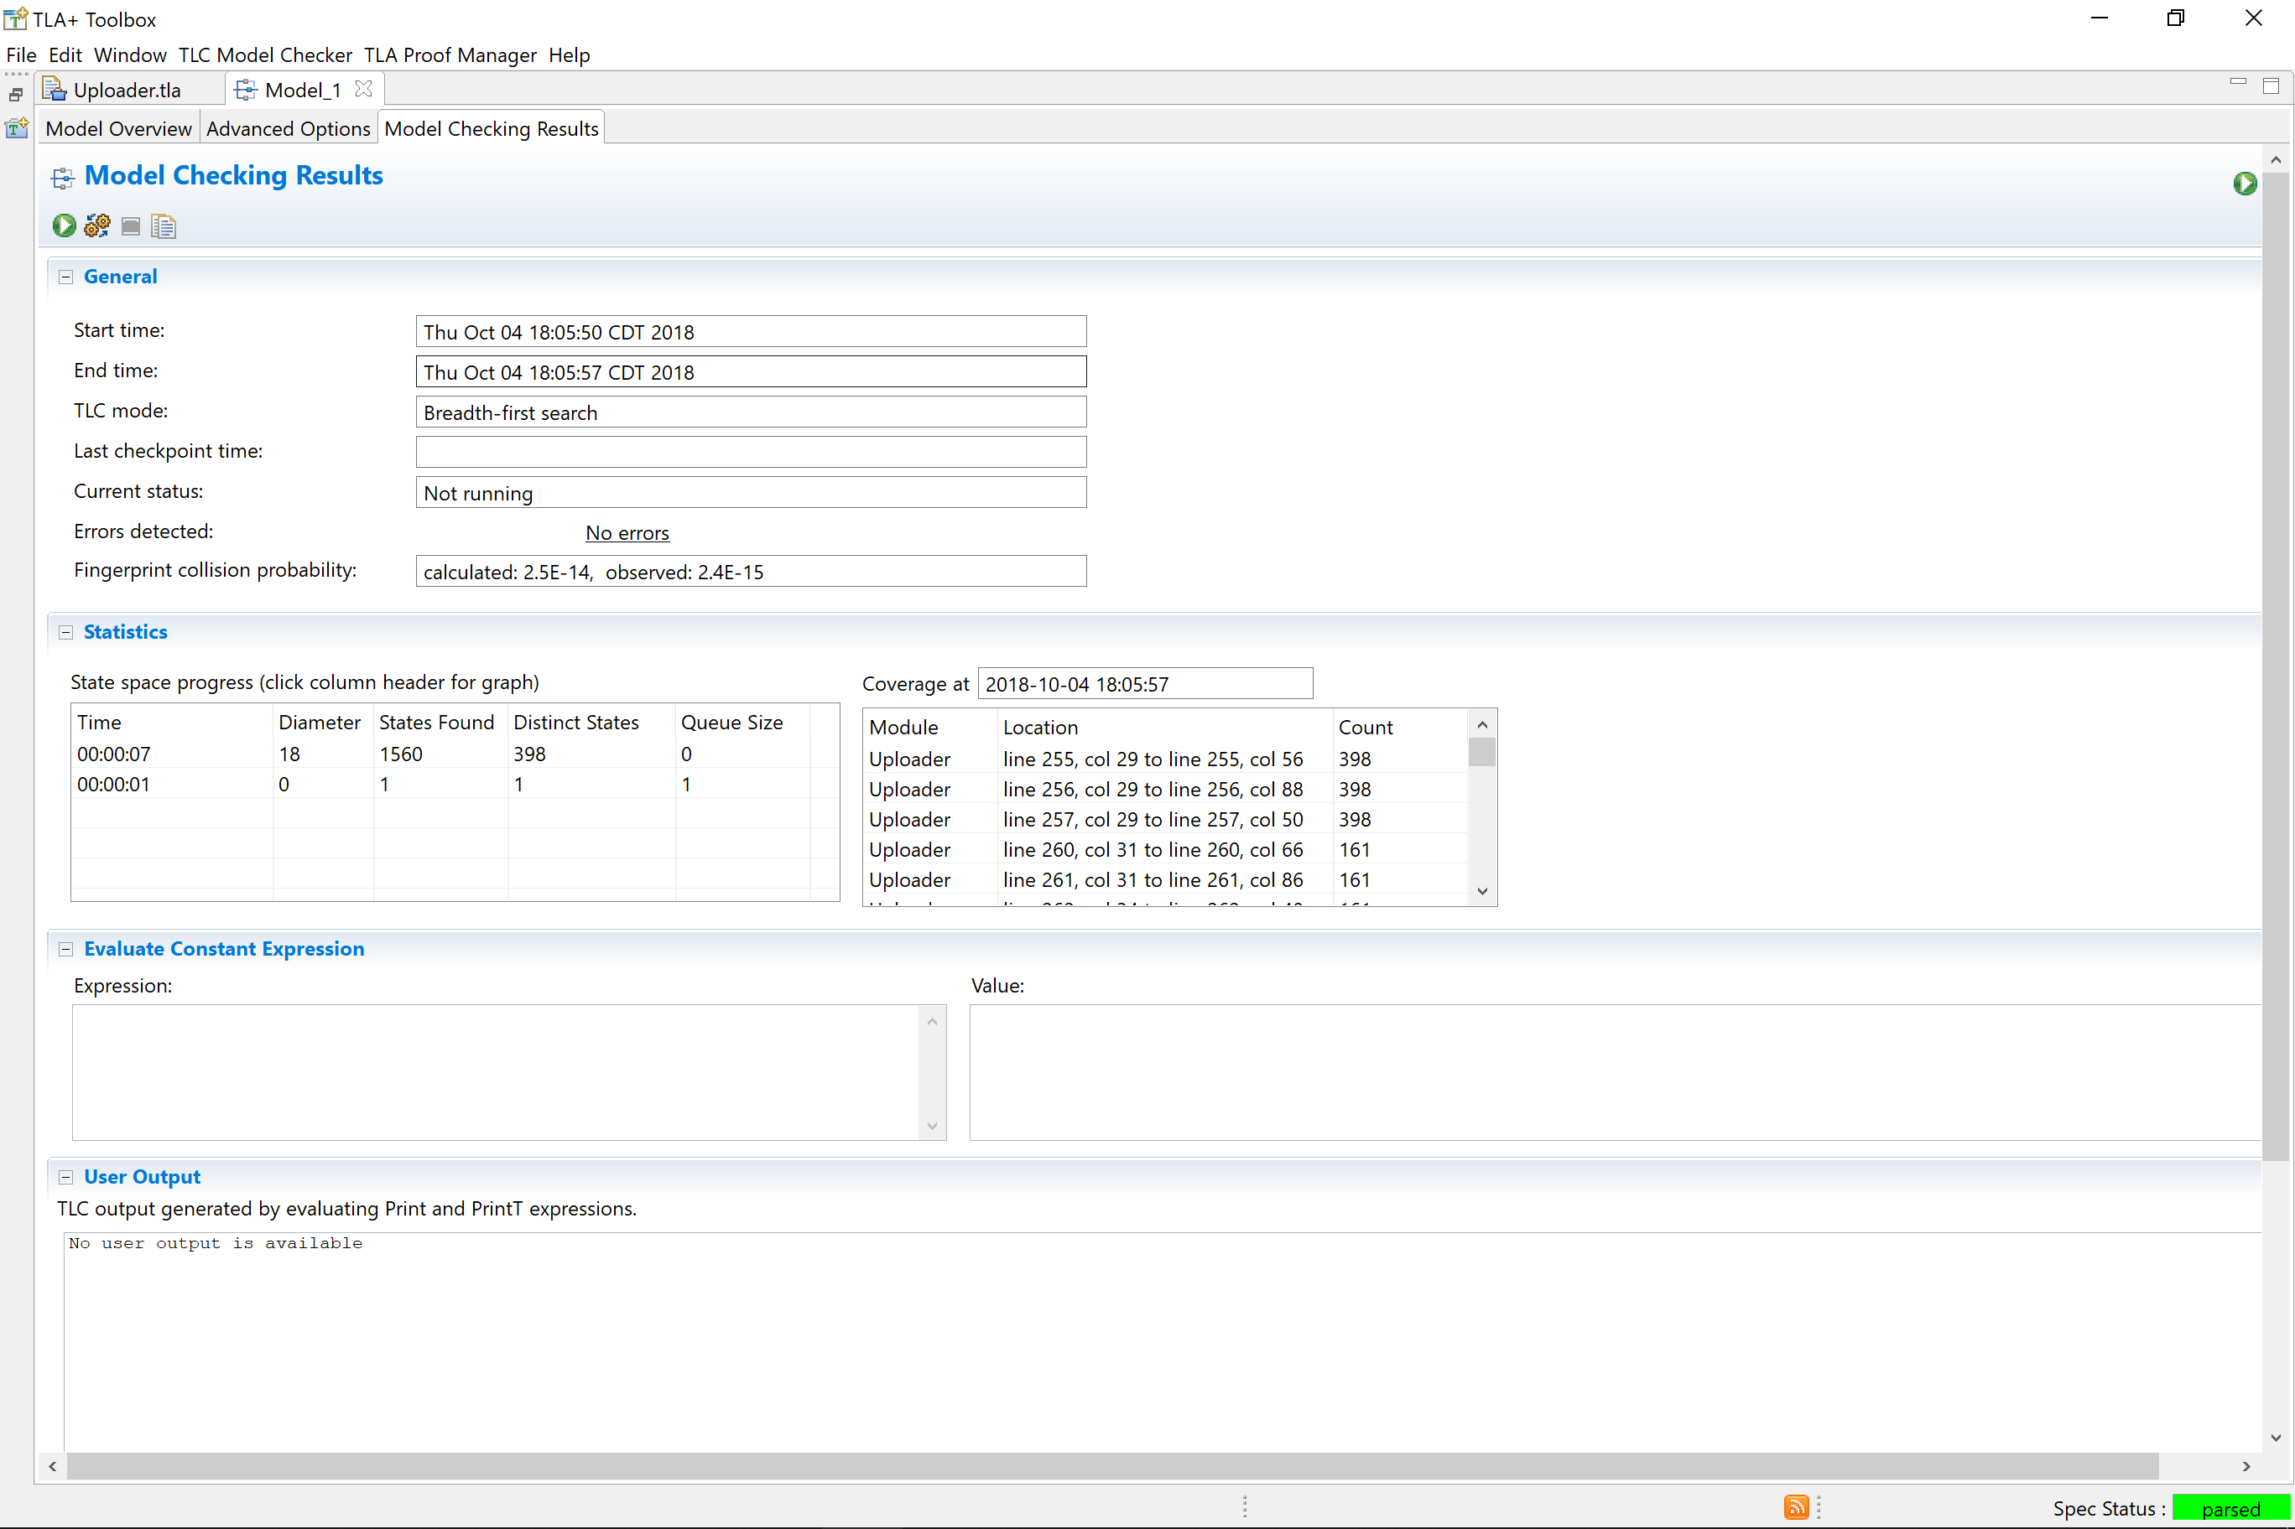
Notes:
Both together is error free!

Slide 108
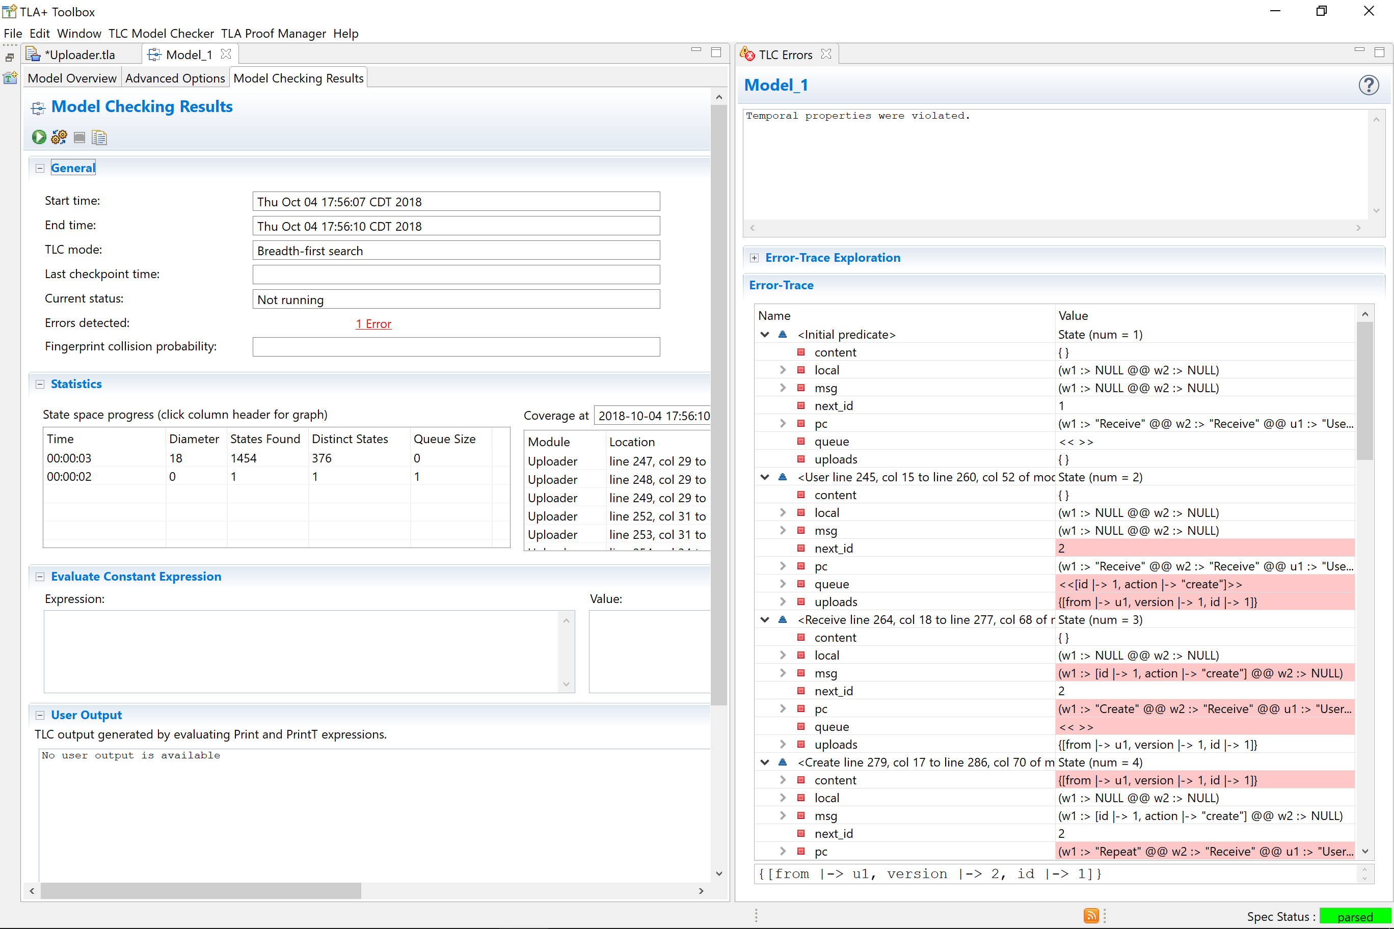

Slide 109
Duplicate messages
Dropped messages
Permissions
Partial failure
Webhooks

Slide 110
Does it work?

Slide 111
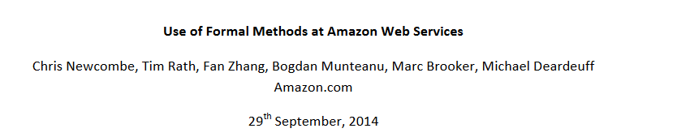
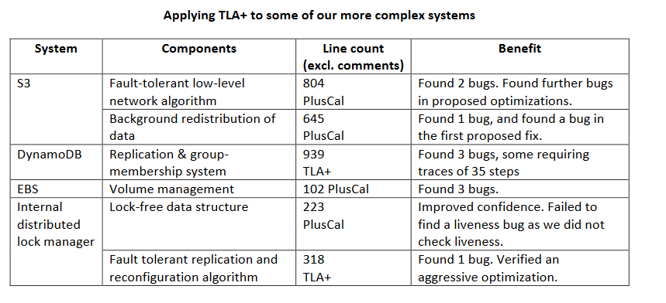
Notes:
https://lamport.azurewebsites.net/tla/formal-methods-amazon.pdf

Slide 112

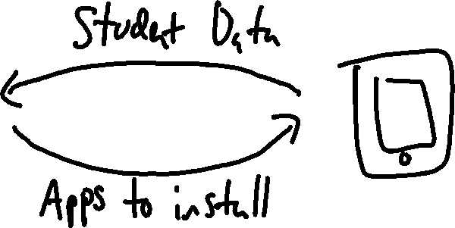
Notes:
I work at a company called eSpark
We assign students lessons. Lessons have curated apps. We send apps to devices
Simple system nothing bad ever happens

Slide 113
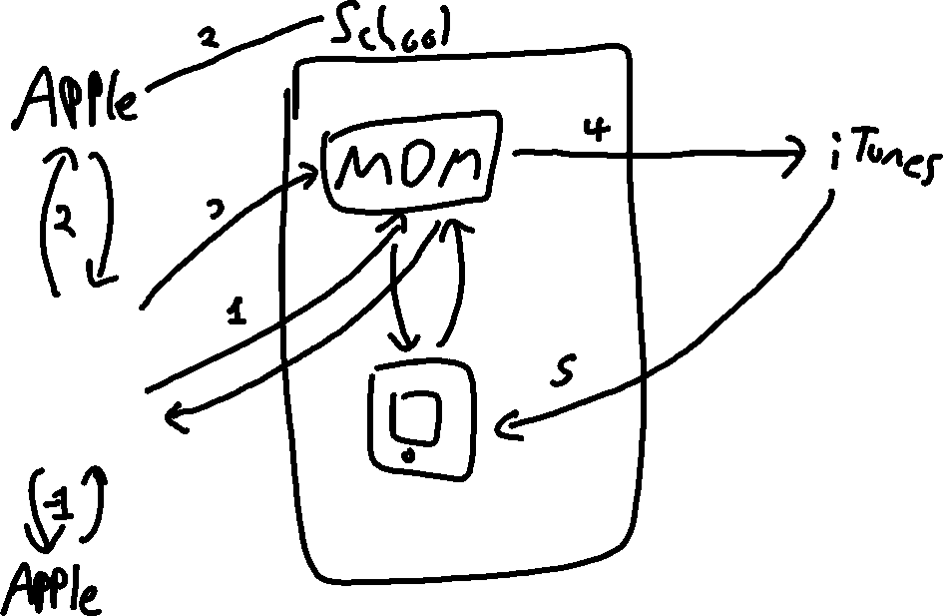
Notes:
The system is incredibly complicated. This is an oversimplification. Many things can go horribly wrong
My job is to keep it working
Us bug, 3rd party bug, wifi is down, timmy and his friends played "send your ipad to heaven"
Lots involved with that, gonna focus on just concurrency

Slide 114

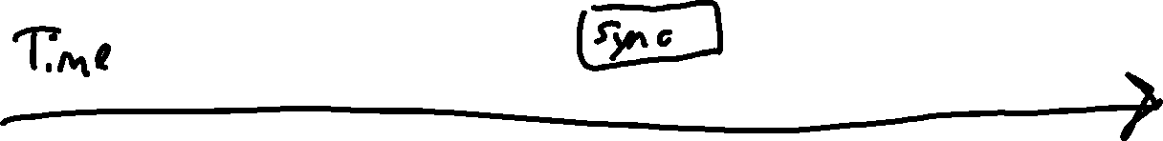


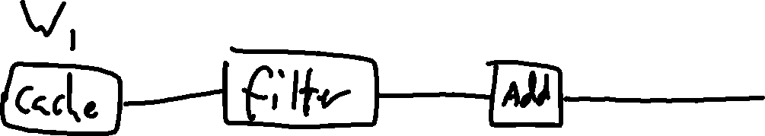
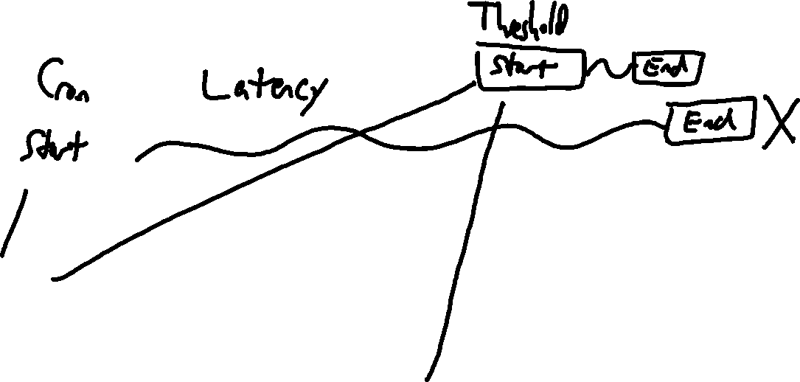
Notes:
Found a pretty nasty bug we would have walked right into
Two workers doing diff actions
Would have cause us a long time to track down the source in prod
Took about five minutes to validate the fix

Slide 115
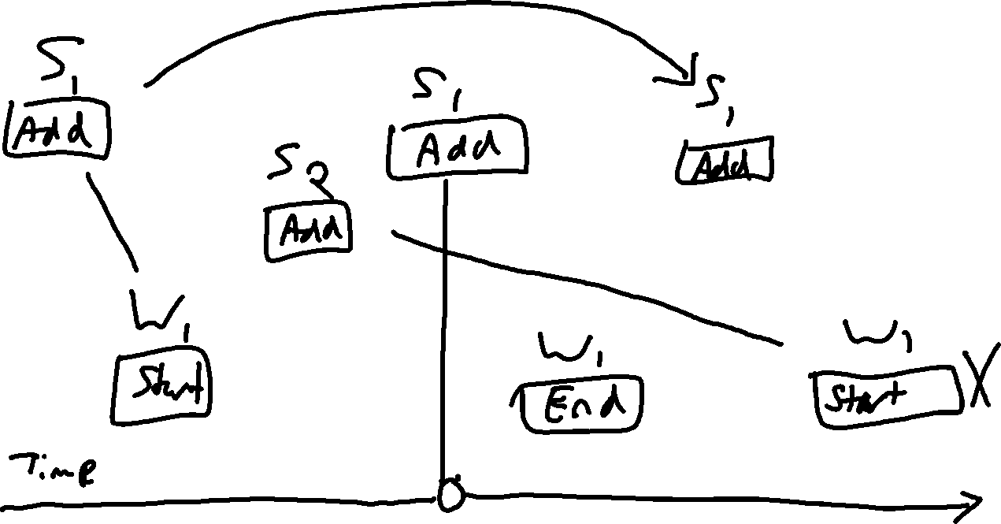
Notes:
Our existing system would have violated it
We thought we had a fix…

Slide 116
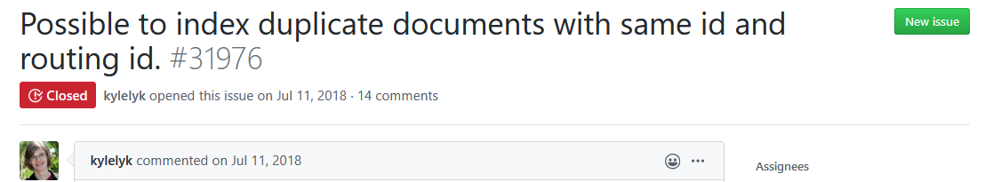
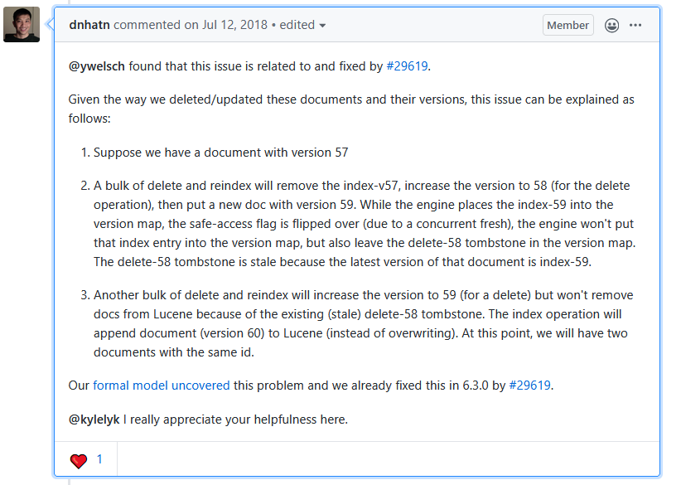
Notes:
https://github.com/elastic/elasticsearch/issues/31976#issuecomment-404722753
https://github.com/elastic/elasticsearch-formal-models/pull/29
https://github.com/DaveCTurner/elasticsearch-formal-models/blob/8ac6716ac359dbe9cbd50da657c39fb33a02822f/ReplicaEngine/tla/ReplicaEngine.tla

Slide 117
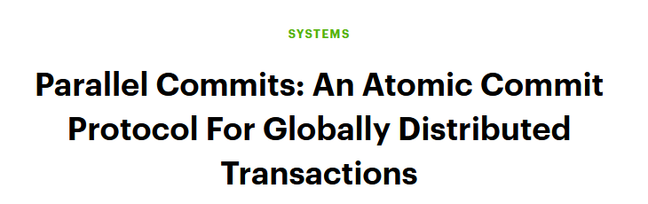

Slide 118
Companies using TLA+
AWS
Amazon
Azure
Xbox
eSpark Learning
Sutori
Elastic
Mongo
ING
Auxon
OSOCO
OpenStack
CockroachDB
Protocol Labs
Facebook
Cigna
Shopify
Auth0
Several clients under NDA
Like 80 blockchain companies
Notes:
Here are a list of companies I've either worked with, or have publically talked about their use of TLA+. Now some are big companies you'd expect, cloud providers like AWS and core infra like Elastic. Others are customer facing: eSpark had eight engineers, Sutori had two. B2B, B2C, etc. Turns out being able to design better is widely applicable!

Slide 119
Conclusions
Distributed Systems are Terrible
Specification helps
TLA+ is neat

Slide 120
Practical TLA+
Me
Beginner level
Tons of practical examples
MapReduce!
Business Workflows!
Rate Limiting!
Out now!
is.gd/ptlaplus
Notes:
Rate limiter

Slide 121
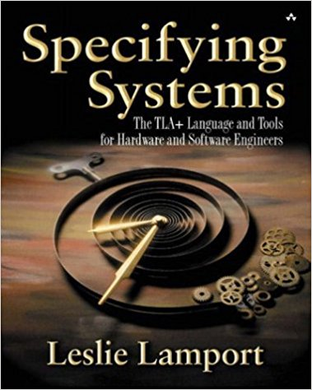
Specifying Systems
Leslie Lamport
Intermediate level
Canonical Text
Covers theory
"The TLA+ Video Course"
Notes:
Rate limiter

Slide 122
Just Hire Me Lol
I do workshops!
intense ones
www.hillelwayne.com/consulting
Or talk to me after

Slide 123
Thank you!
@hillelogram hillelwayne.com/talks/distributed-systems-tlaplus is.gd/ptlaplus

